Slide 1
AGORA Revisited: A Replication Study on Innovative Test Oracle Generation for Advancing the Robustness of REST APIs
PROJECT PLAN PRESENTATION
Presentation By Parth Shah, Sankaranarayanan Srinivasan, Harshini Reddy Koukuntla, Taruni Movva
February 14, 2024

Slide 2
The Research Questions
This replication study aims to address the following primary research questions:
a. How does the performance of AGORA scale with larger datasets of API requests and responses? Are there any bottlenecks in the system as the dataset size increases?
b. How does detecting and reducing duplicate input requests affect the performance of AGORA's API testing process?
c. How do different configurations of JSONMutator mutation operators affect the failure detection ratio achieved by AGORA?

Slide 3
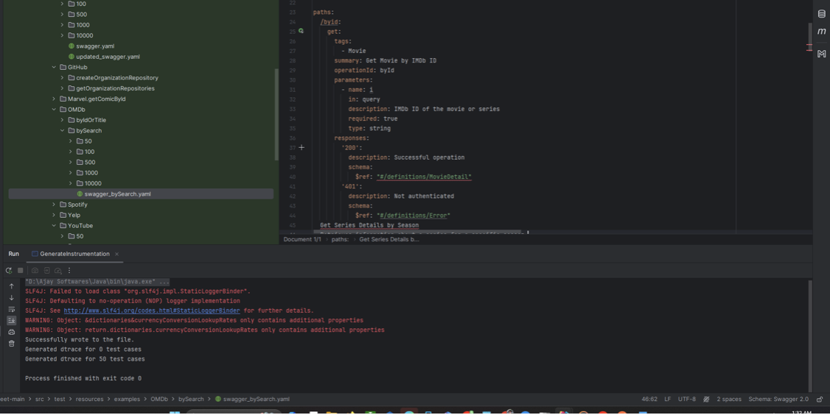
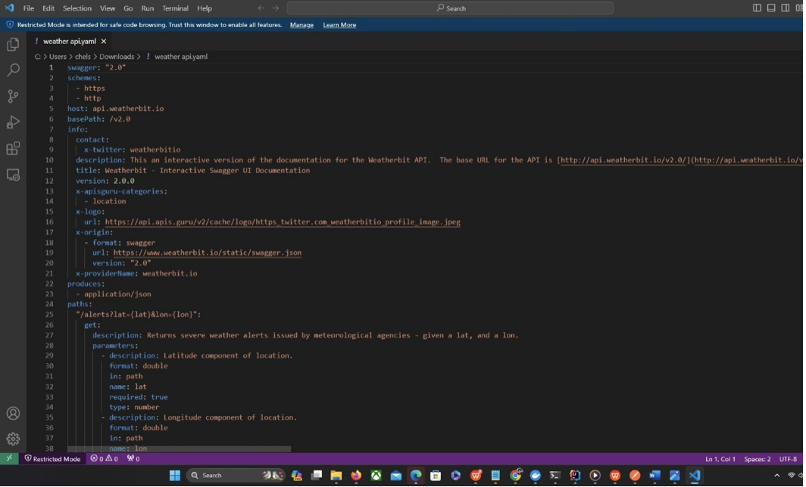
RQ - 1 : Evaluating AGORA's Performance with Larger Datasets
Approach Overview:
Developed two primary approaches to assess AGORA's scalability with enhanced datasets
Approach 1: Expanded OMDB dataset with new sources like "Get Series Details by Season."
Approach 2: Integrated Weather API obtained from APIs.guru for numerical data.
One of the sources incorporated to expand the OMDB dataset
OpenAPI Spec for the Weather API

Slide 4
Data Expansion:
Expanded OMDB dataset to include diverse sources suitable for various data types.
Integration of Weather API to evaluate AGORA's ability in handling arithmetic comparisons.
Analysis Process:
Generated API responses for endpoints, ensuring adherence to OpenAPI format.
Organized responses into folders by dataset size using POSTMAN tool.
Utilized BEET and IntelliJ IDE for creating .decl and .dtrace files, and Docker for Daikon execution.

Slide 5
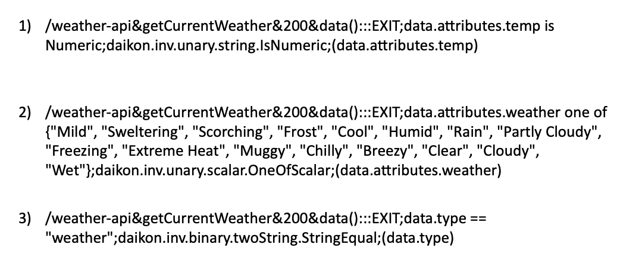
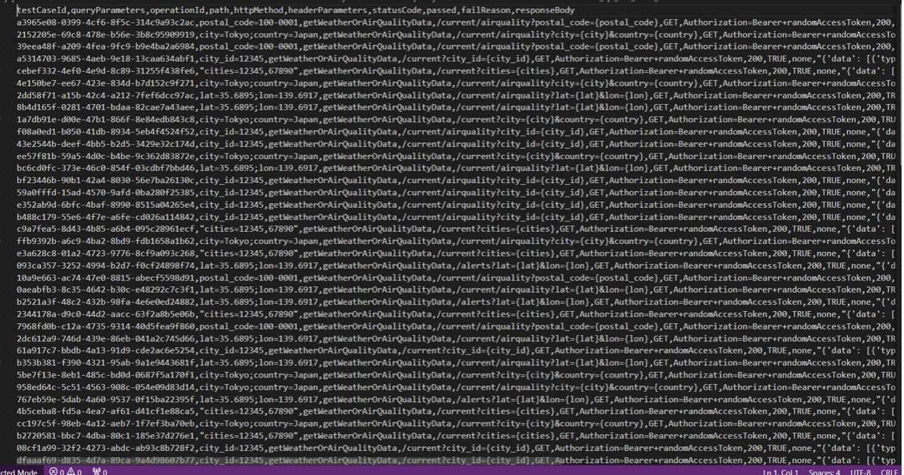
Here is the example of the generated invariant for the weather API Response
snapshot of the generated endpoint

Slide 6
Primary objective:
Assess AGORA's performance using enhanced datasets.
AGORA employs Dynamic Program Analysis, effectiveness influenced by data quality and quantity.
Confidence in AGORA's efficiency improvement as dataset size expands.
Efficiency Measurement:
Efficiency formula: Efficiency = Number of relevant invariants generated from the extended dataset / Total number of invariants generated from the authors' dataset.
Emphasize the importance of measuring AGORA's efficiency for larger datasets compared to the existing dataset.

Slide 7
RQ - 2 : Impact of Duplicate Requests reduction on AGORA’s performance
• Our initial analysis of the AGORA dataset revealed a significant presence of duplicate input requests.
• We observed that the existing agora dataset is utilizing duplicate inputs (i.e., API Request endpoints) for Beet to evaluate invariants using the modified version of Daikon.
• We identified that the "createPlaylist" endpoint had duplicate api requests with the identical 'userid' parameter. In a similar vein, the "getAlbumTrack" endpoint was called with the 'market' parameter consistently across requests.
• The redundancy of these inputs can potentially skew the performance metrics of the API testing process, leading to inefficiency in both testing efforts and resource utilization.

Slide 8
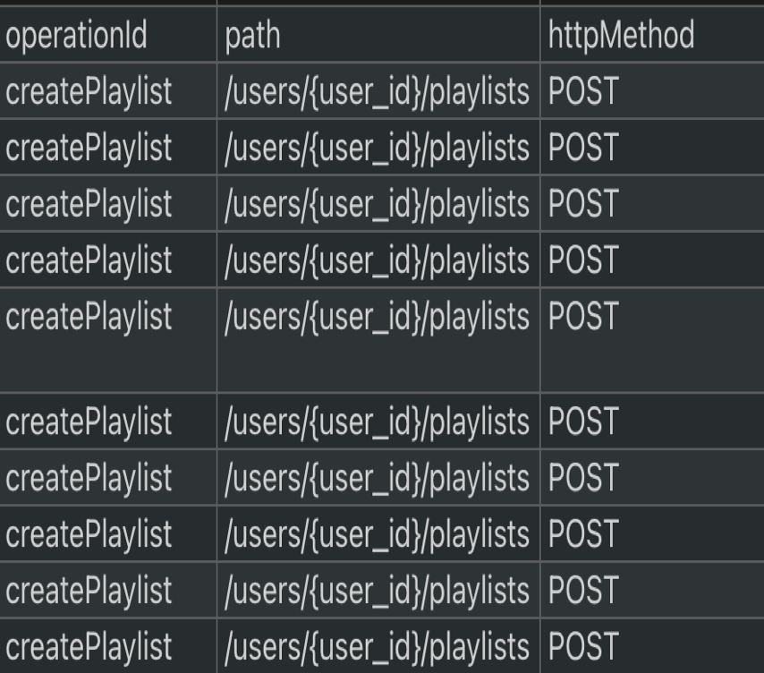
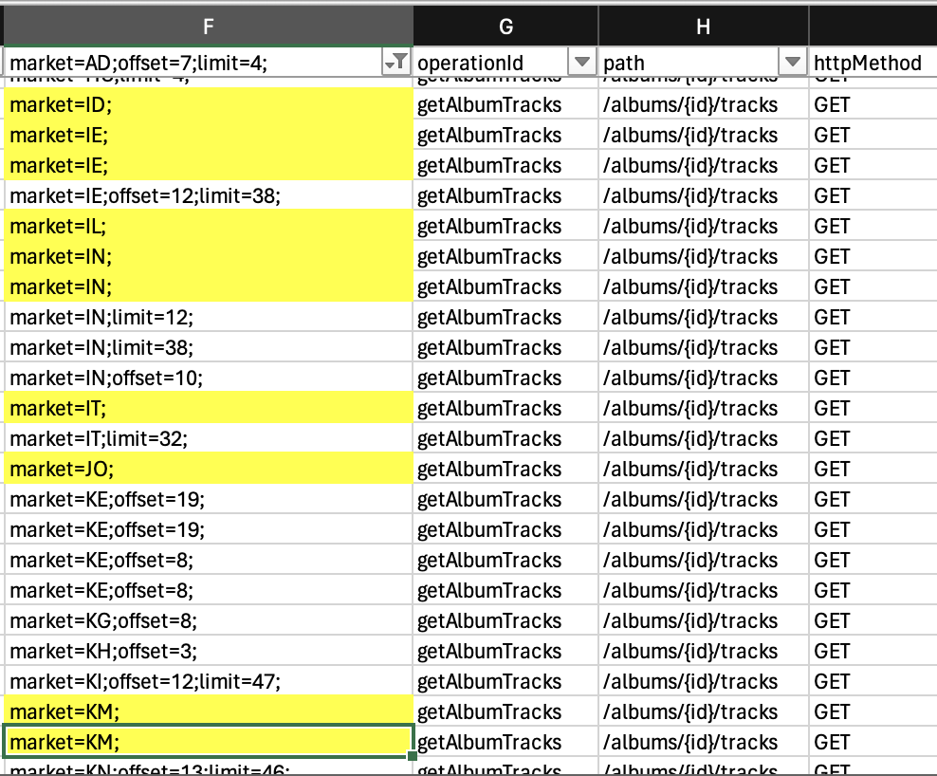
Example – Spotify REST API
createPlaylist
getAlbumTracks

Slide 9
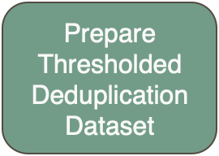
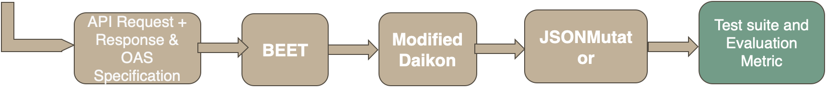
Plan
Experiment 1
We will set a threshold value to control duplicate REST API requests in industrial REST API datasets. We will keep duplicate records up to threshold value and give dataset csv and OAS Specification to Beet as an input. After modified daikon will use result of beet to produce invariants.
We will run JSONMutator tool to generate the test suite for new dataset which has duplicate API requests (duplicates limited to threshold). We will detect if there are new invariants generated and what is the impact on test suite.
Expected output:
AGORA should generate the new unique invariants after removing or reducing number of duplicate input

Slide 10
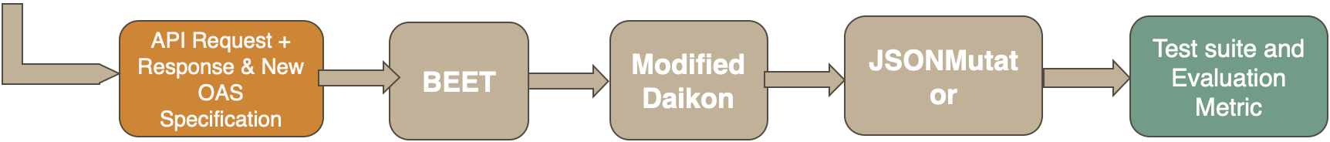
Plan
Experiment 2
In this experiment, we will perform exactly the same steps as Experiment 1 but will provide a different OAS specification that we are going to modify for another research question and record our observations.
For removing duplicates, we will use the duplication removal utility which takes threshold value as input and then prepare the data based on that threshold value.

Slide 11
Evaluation Metric
1.Number of unique invariants identified
This metric will help assess the impact of removing duplicates on the diversity and richness of the invariants generated. A higher number of unique invariants could indicate more thorough test coverage.
2. Mutation Score
Apply mutation testing to the application and use the test suite to detect the mutants. The mutation score (percentage of mutants detected) can be a robust indicator of the quality of the test suite.

Slide 12
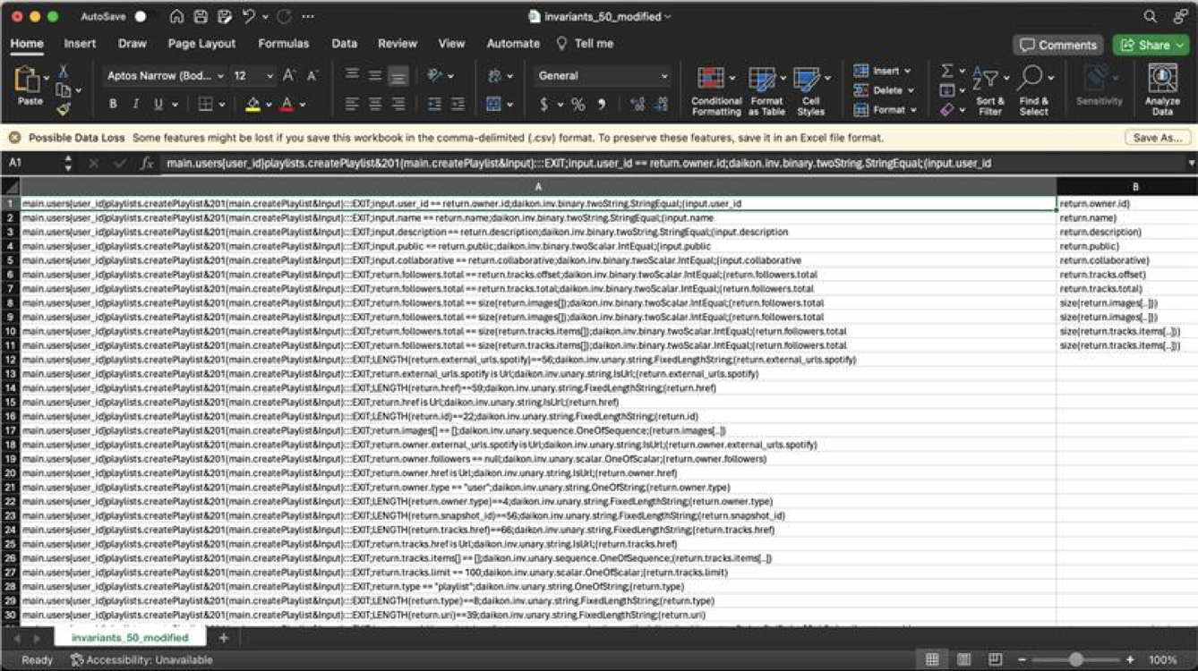
Initial Findings – Experiment 1
Authors’ Output - 50 duplicate createPlaylist REST API - 43 invariants

Slide 13
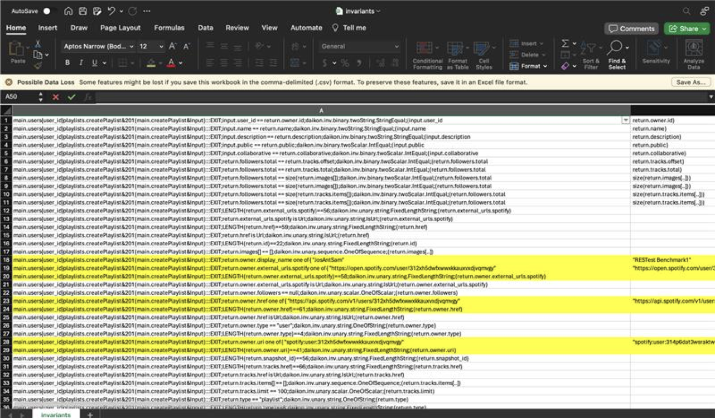
Initial Findings – Experiment 1
Experiment 1 – 5 (threshold value) duplicate REST apis - 50 invariants
Findings - 7 new invariants found.

Slide 14
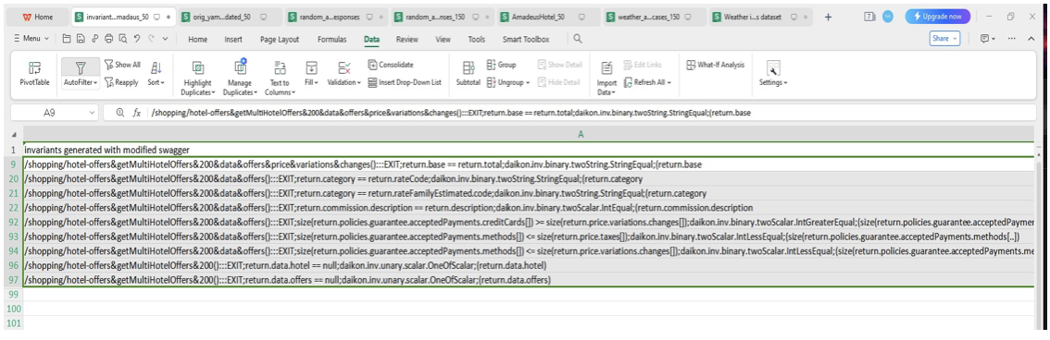
RQ - 3 : Investigating the Impact of Dataset and Time-based Mutations on AGORA's Fault Detection
Purpose: To explore the impact of various factors on invariant generation and AGORA's failure detection capabilities.
Approach: Conducted three experiments to analyze the effects of dataset changes and time-based mutations.
Snapshot of the findings from experiment 1

Slide 15
Experiment 1: Updating OpenAPI Format with Existing Dataset
Details:
Utilized the Amadeus Hotel API for comparison between different versions of Swagger files.
Highlighted Changes:
Version Update: Transition from 3.0.5 to 3.0.8 with potential bug fixes or updates.
Consistent Endpoints: Stability observed in API functional range.
Parameter Adjustments: Minor modifications noted impacting invariant generation.
Enhanced Enumerations and Additional Properties: Improvements in data categorization and description.
Analysis Outcome:
Daikon identified fewer invariants in the modified version, mainly due to parameter changes.

Slide 16
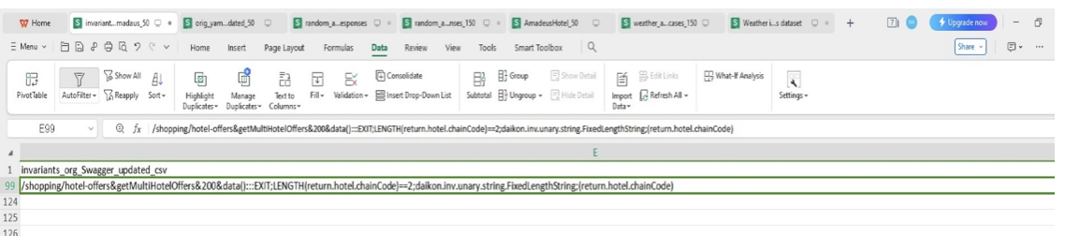
Experiment 2 : Updating API Responses with Previous Version of OpenAPI Format.
Details:
Kept OpenAPI version constant while altering API response parameters for the Amadeus Hotel API.
Minimal differences observed in generated invariants between original and modified versions.
Conclusion: Minor modifications in API responses have limited impact on invariant generation and fault detection ratio.

Slide 17
Experiment 3: Time Based Mutation Analysis for HRMS API
Details:
1.Importance of Time-based Mutations for APIs with time-sensitive data.
2. Examples of Mutations:
Adjusting Timestamps
Modifying Durations and Intervals
Changing Expiration Dates
3. Implementation Steps:
Identifying Time-Sensitive Data
Developing Custom Mutation Operators
Mutation Testing with AGORA
4. Expected Outcome: AGORA should identify faults assuming accurate time-based invariants generated by Daikon.

Slide 18
THANK YOU

